Slide 1
Executive Summary
Arindam Samanta
DSC640-T302
Bellevue University

Slide 2
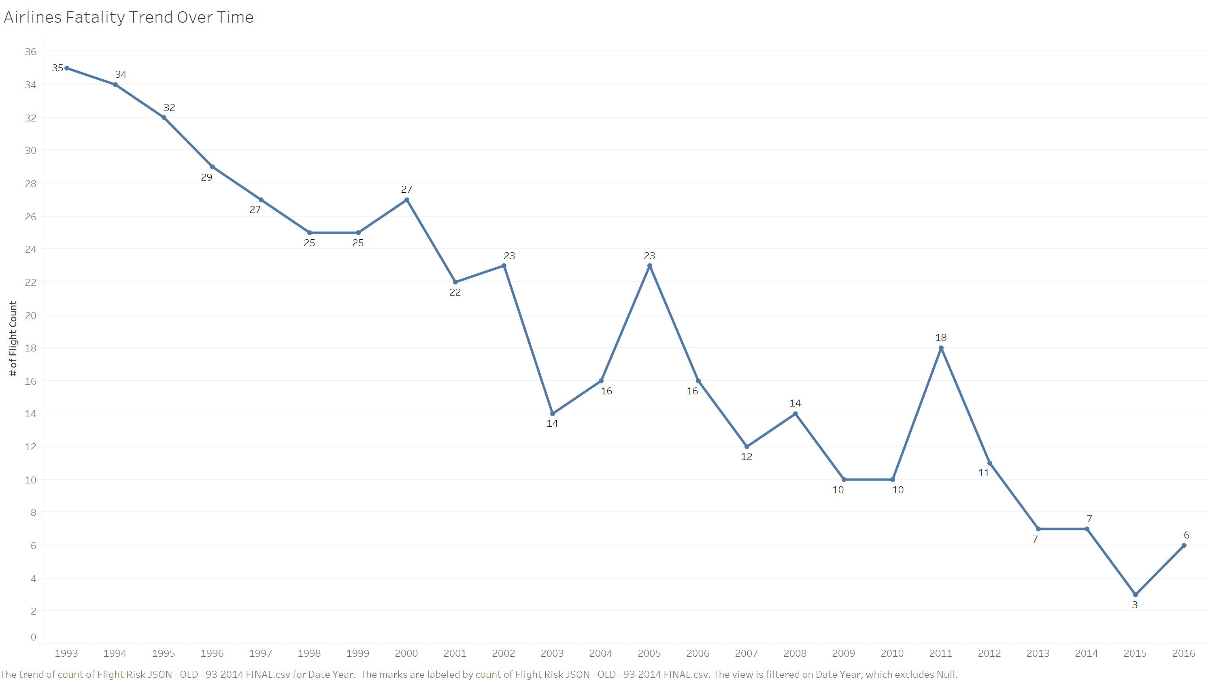
Declining Trend of Airlines Fatality
Period under consideration is 1993-2016
With few exceptions we see a general trend of declining fatality across all airlines

Slide 3
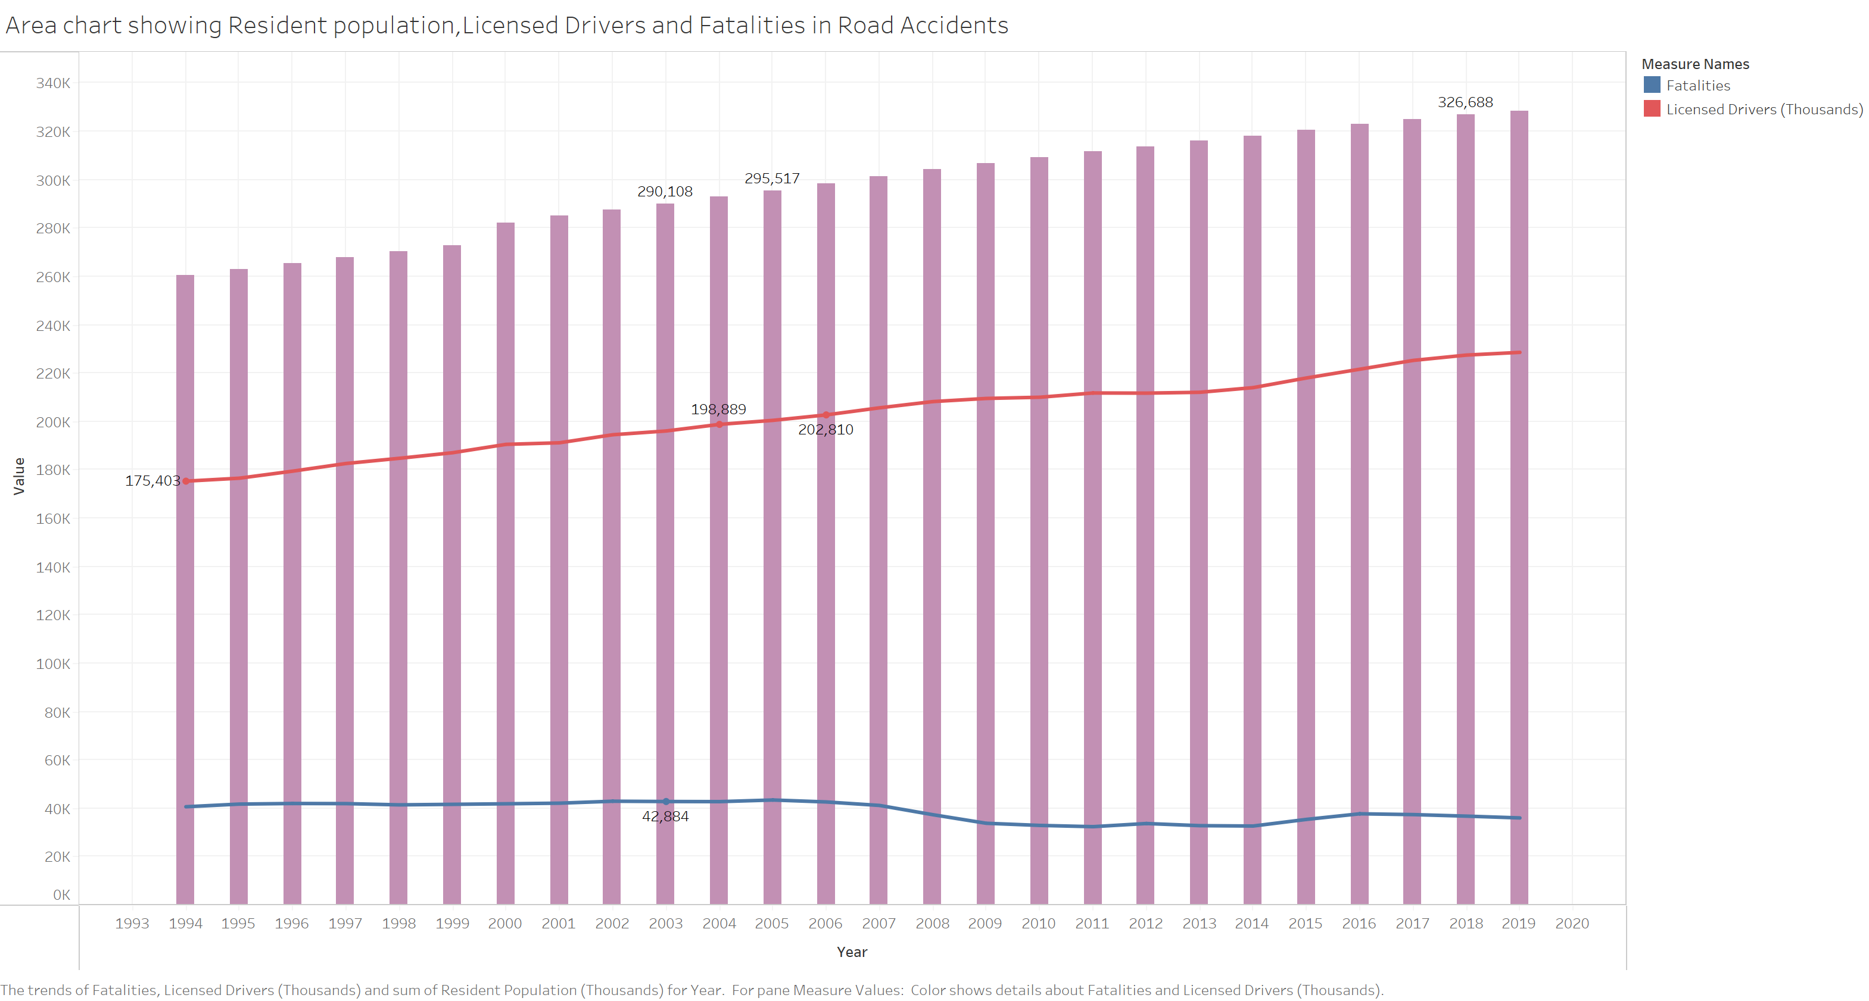
Fatality Trend Among Drivers
Period under consideration is 1994-2019
The fatality trend remains almost the same across the years
Road fatalities as percent of licensed drivers are quite high

Slide 4
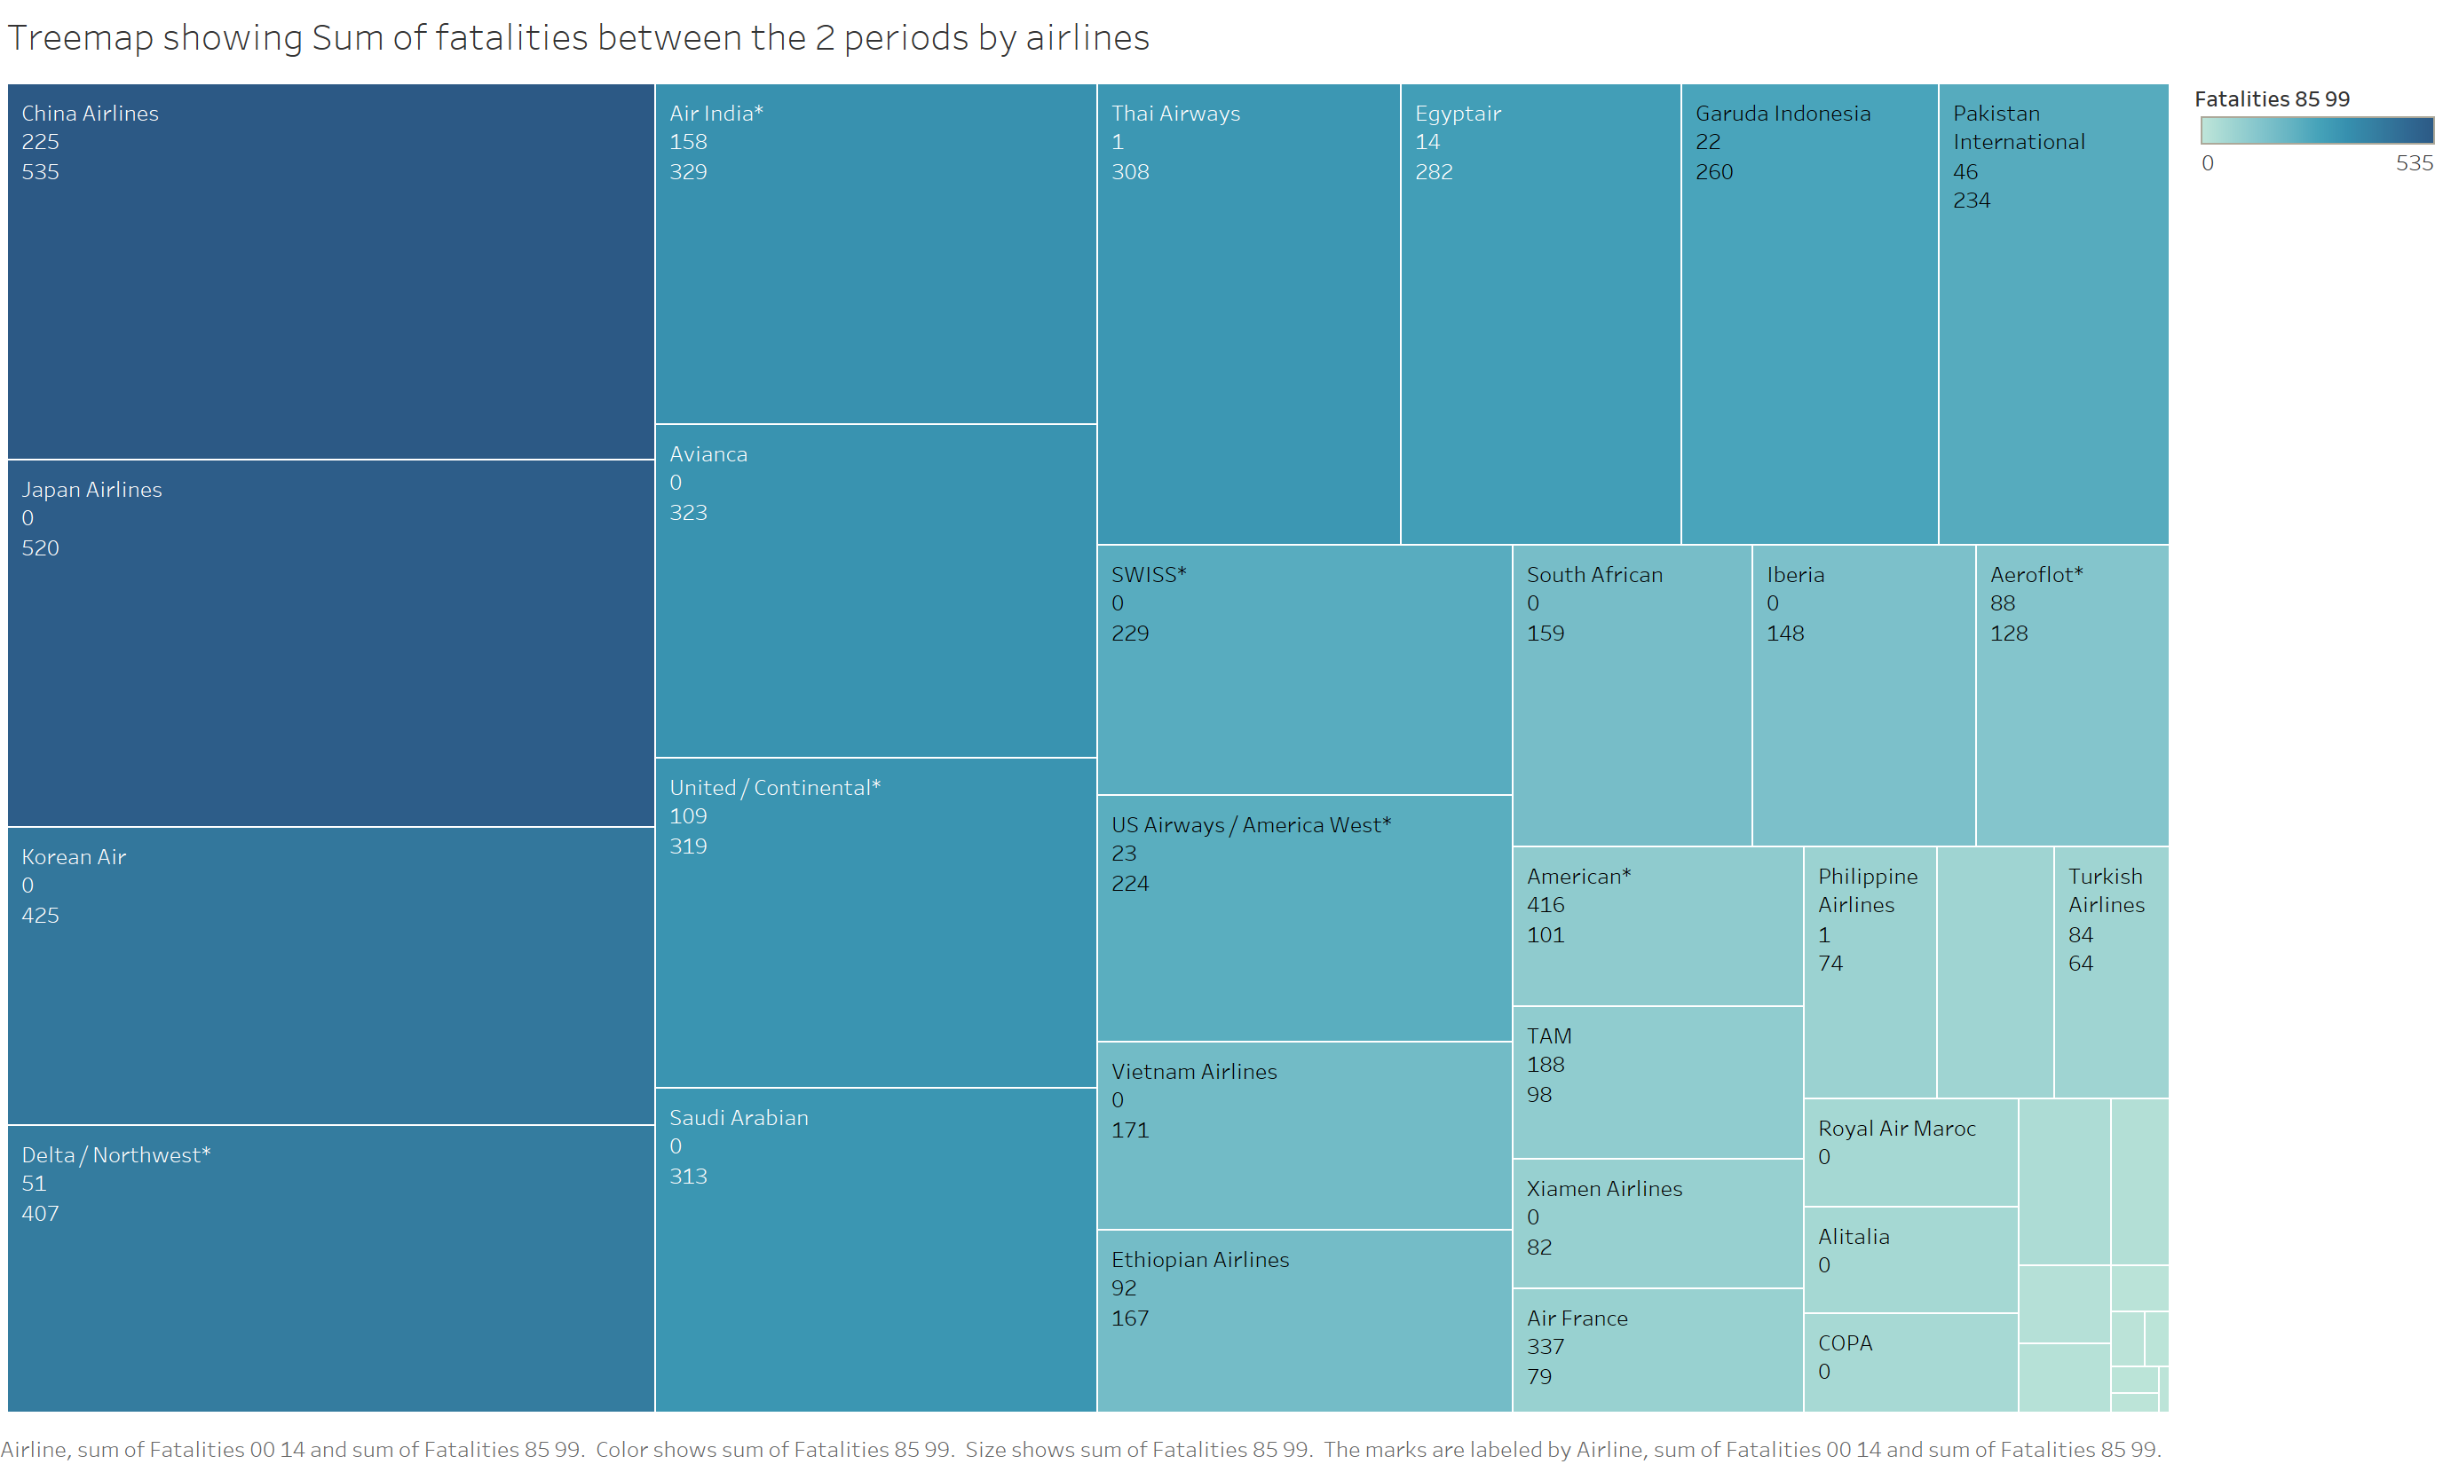
Fatality Count by Airlines
Fatality count by airlines also shows how the count is coming down in the next 15 years

Slide 5
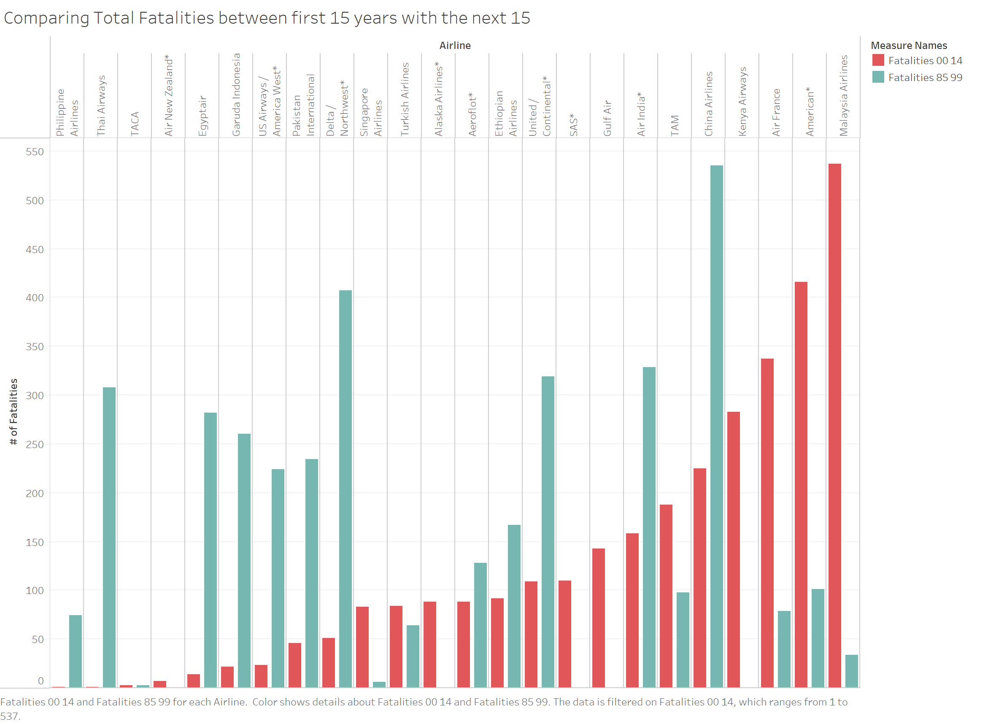
Reduced Fatalities by Airlines
For each of the airlines fatality count decreased from the first 15 years to the next
However, Malaysian,American and Air France are exceptions unfortunately
Overall flight safety has improved a lot

Slide 6
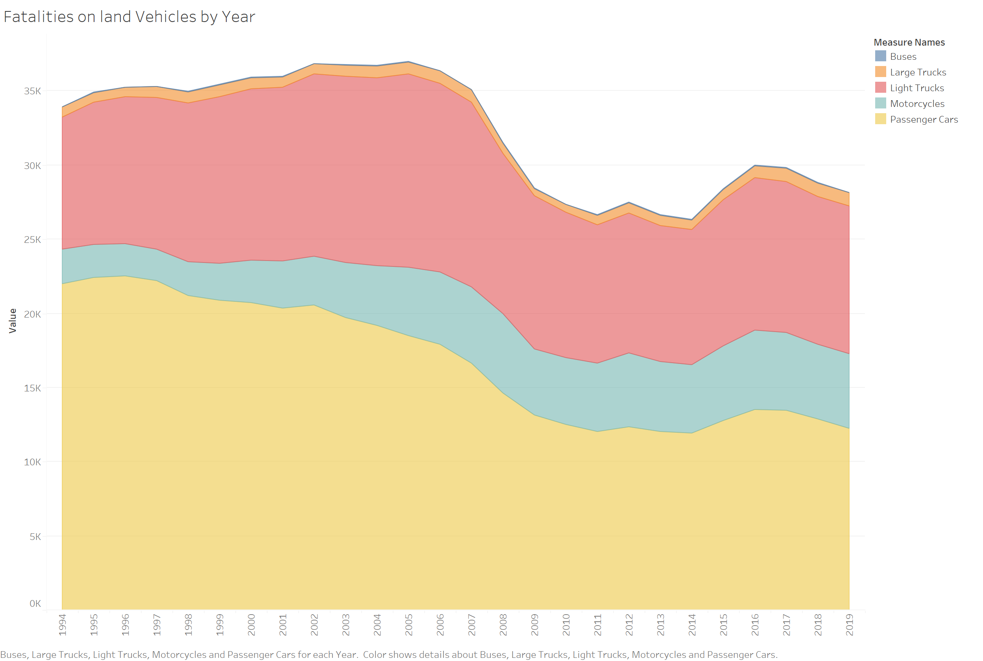
Fatalities by Various Land Based Vehicles
Trend is from 1994 to 2019
But the count is much higher than airlines fatality

Slide 7
References and Links
Main Data Source:
https://github.com/fivethirtyeight/data/tree/master/airline-safety
Supplemental Data Sources:
Motor Crashes - Downloaded from: https://www.iihs.org/topics/fatality-statistics
U.S. Air Carrier Safety Data - Downloaded from: https://www.bts.gov/content/us-air-carrier-safety-data

Slide 8
THANK YOU

